Slide 1

Notes:
Jerry
Good Afternoon! It’s my pleasure to be here with you today as a member of the Why Rural Matters 2025 research team. On behalf of our team, I would like to begin by offering our thanks to Allen Pratt for his vision in bringing Why Rural Matters to NREA and to Melissa and Dave for shepherding that vision forward. We would also like to thank Elizabeth Beeson and Marty Strange for initiating the project 25 years ago with the first report, and to Rob Mahaffey and staff at the Rural School and Community Trust for leading this up to and through the transition to NREA in 2023. We are very excited to be at NFARE to share this year’s report!
The 2000 inaugural report by Beeson and Strange was the first of its kind to provide an analysis of rural education in each of the fifty states. Since that first version, the report has been published 10 more times. Over the past 25 years the report has been used countless times by rural education advocates, researchers, and policymakers to highlight rural challenges as well as to identify areas of strength in rural schools and communities.
The purpose of the report has remained the same throughout: to capture the scope and scale of rural education, to characterize its diversity, to call attention to needs and opportunities, and to prompt further consideration of ways to better support rural schools and communities. We do this using different kinds of content – visual and narrative representation of results, and topical essays that take a deeper dive into specific areas.
-- while giving the report intro, also briefly mentions the three findings that aren't directly related to topical essays. Two of these (unhoused and multilingual) will have videos with them. The third (health) can just be a couple sentences; maybe even directly reading the key finding on health.
Dan -- takes the data source slide (was in Jerry's) and then talks about the rural def. change, which is a key finding and topical essay.
Karen -- discusses findings, etc. from the charter school essay
Bob -- talks about the inclusion of BIE data in this report along with the key finding on BIE and mentions Alex's essay (note: If Alex is coming to the conference, we might adjust this? I emailed Alex to check if he's coming...). Plays the 2 videos related to BIE as part of this section.
Sara -- discusses findings, etc. from teacher qualifications essay and also presents the key finding on NAEP scores. Transitions to Melissa.

Slide 2

About the Report
Developed by the National Rural Education Association (NREA)
11th in a series of reports
Analyzes the contexts and conditions of rural education in 50 states
New in this year’s edition is the inclusion of Bureau of Indian Education (BIE) schools
Includes new topical essays

Slide 3

About the Data
Data used in Why Rural Matters 2025 come from public sources, including:
National Center for Education Statistics (NCES)
U.S. Health Resources & Services Administration
U.S. Census Bureau
For this report, rural is defined using the three rural locale codes as determined by the U.S. Census Bureau.

Slide 4

Key Findings
Changes in how rural is defined and calculated, and perhaps other reasons, mean that states will have to adjust policy and resources
Data from Bureau of Indian Education schools demonstrate dire needs and challenges
The rural population across the United States is racially, ethnically, and linguistically diverse

Slide 5

Key Findings
Students in rural areas have fewer health care supports than their peers across the United States
Lower mobility and housing insecurity reflect rural community resilience
NAEP scores highlight rural successes amidst continuing challenges

Slide 6

Five Gauges

Slide 7
Five Gauges
Five gauges to describe the condition of rural education in each state
Each gauge includes five equally weighted indicators, for a total of 25 indicators
The higher the ranking on a gauge, the more important or urgent rural education matters are for that particular state

Slide 8
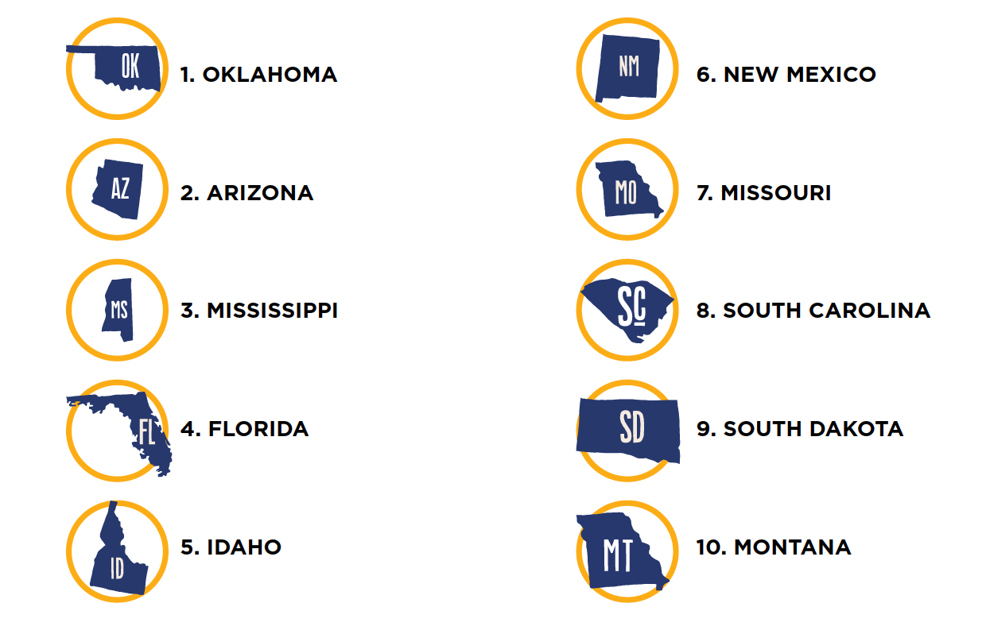
Top 10 Priority States
The Why Rural Matters report researchers combined the five average gauge rankings to determine an overall average ranking, which we term the Rural Education Priority ranking.

Slide 9
State Specific Slide(s)
Customize slide(s) to highlight data/state rankings from your state

Slide 10
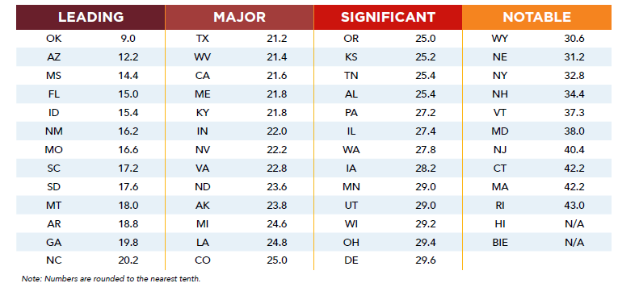
Rural Education Priority Gauge Rankings

Slide 11

Alignment NREA’s Rural Research Agenda
Spatial equity is the way that equity is linked to place and explicitly refers to how resources of all types are allocated, how services are distributed within rural schools and communities, and the way rural people are able to access educational opportunities.

Slide 12
Alignment NREA’s Rural Research Agenda
In rural education, spatial inequity is exacerbated by policies that impact funding systems, access to early intervention supports, opportunities for interdisciplinary learning experiences, the availability of mental health services, access to reliable broadband, and much more

Slide 13

Learn More
Report & Communications Toolkit
nrea.net/research/why-rural-matters/
Questions? Contact Dr. Melissa Sadorf, Executive Director, NREA, melissa@nrea.net

